Slide 1

Predict sales for online retail store
Dharit Sura
Springboard Data Science Capstone
Mentor: Raghu Patthar

Slide 2
Future Sales Case Study
Problem Statement – How can the online gift retail store better stock up the goods in order to meet the growing demands?
Context – Online gift retail store has a significant presence in UK and ships internationally too. It is a wholesaler for gifts with over 4646 unique items.
Criteria for success – The future sales should be in under acceptable error rate < 5%
Constraints – The customerId is doesn’t tell much about the customers information. The dataset is restricted to only the records we have received.
DataSource - UCI Machine Learning Repository: Online Retail II Data Set.
Stakeholders – Raghu Pattar

Slide 3
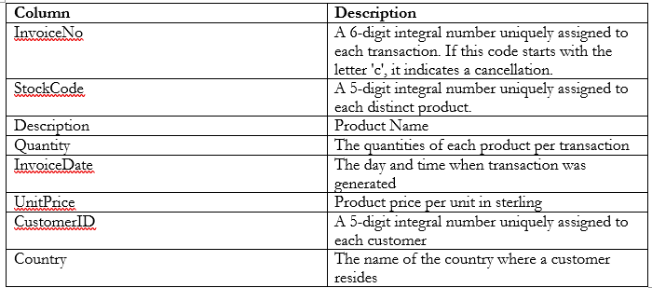
Dataset & Insights
It contains approximately 1.06million records for transactions occurred between 1/12/2009 and 9/12/2011
There are records with (-ve) quantity which is associated with returns for the order items or cancelled invoices
Approx 23% of the records had customerID set as null.
Transactions with price set as 0 were observed.

Slide 4
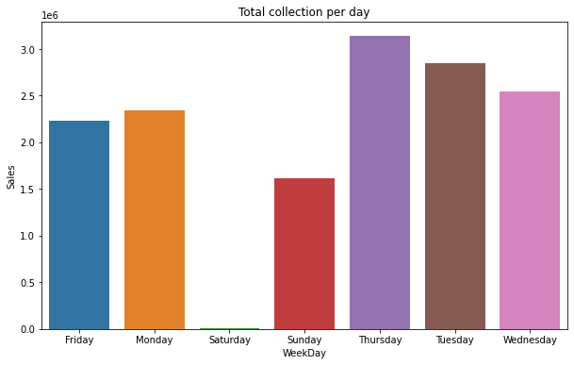
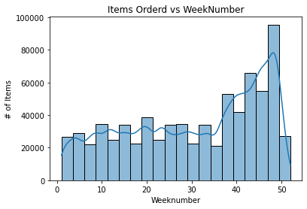
Exploratory Data Analysis

Slide 5
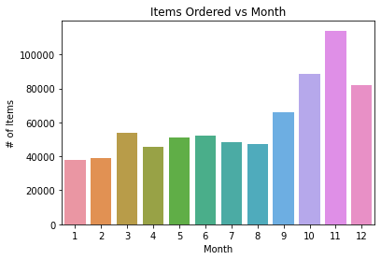
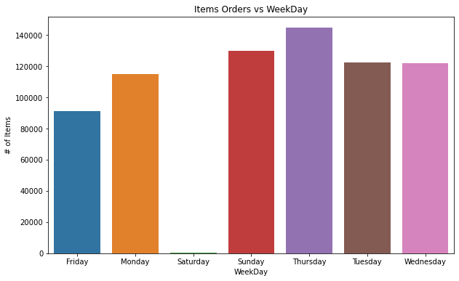
The invoice date was split across multiple different timeframes – week, day, month, year and hour of the day.
Looking at the orders placed based on different timeframes and can see a significant jump towards the last quarter of the year (especially during October and November). This could be probably associated with holiday season (Christmas) coming in December.
To enhance our backing, the UK holiday list is also incorporated.

Slide 6
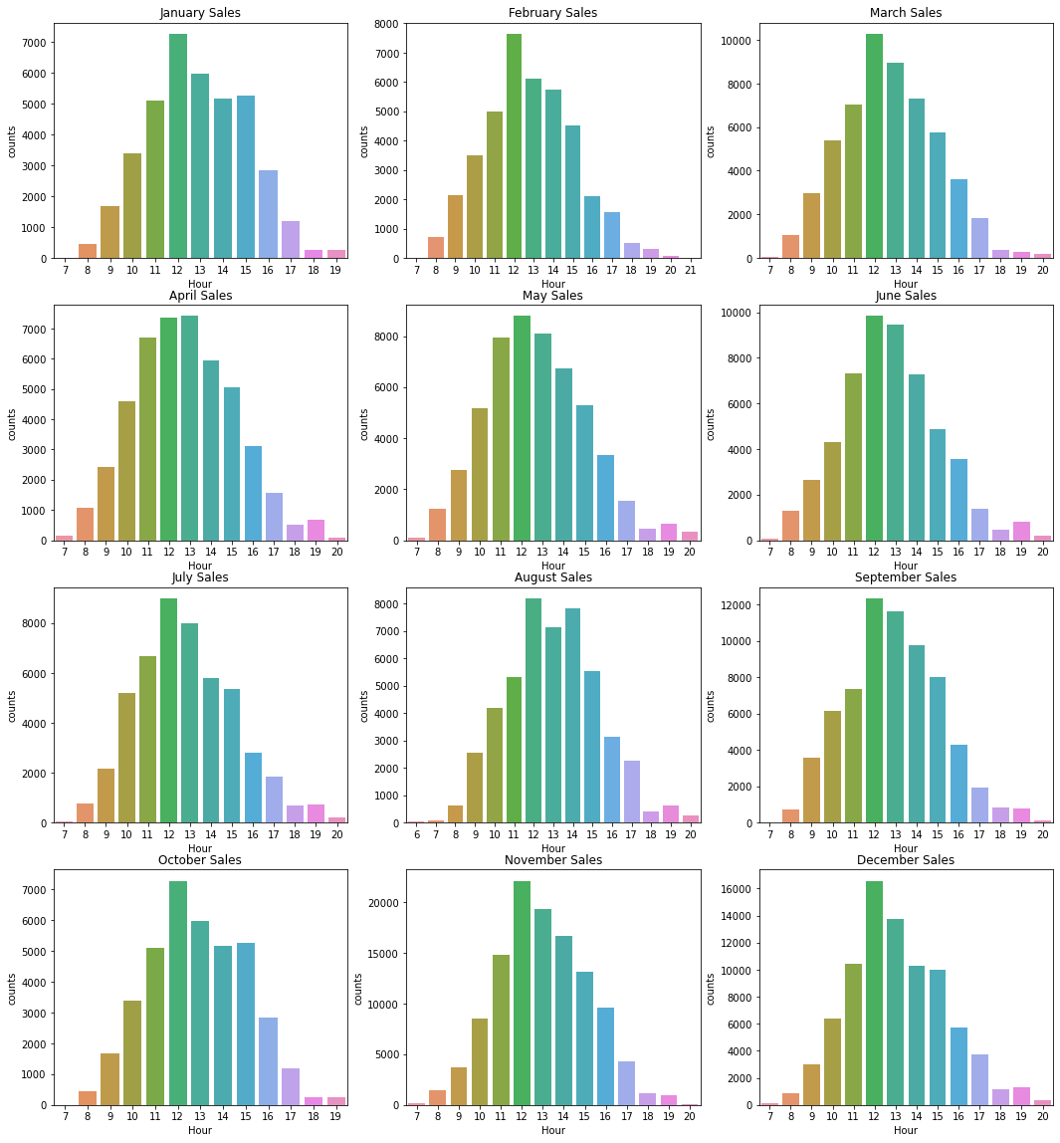
Statistical test
A statistical test is performed inorder to see if there is any difference in the sales patterns across adjacent months.
The outcome was there none of the months showed significant trends except that of (Oct-Nov)

Slide 7
Feature Engineering
Based on our current exploratory analysis, feature engineering technique was used to feed more valuable information to the model.
Since the dataset was biased towards UK dataset, it was split into 2 subsets – UK and the rest of the countries.
Feature engineered columns
Total amount of sales done in a day
Unique orders per day
Average amount of collections per day
Pre 7 and Pre 30 days orders
Is_holiday
Marking any outlier sales_boost received on a particular day.

Slide 8
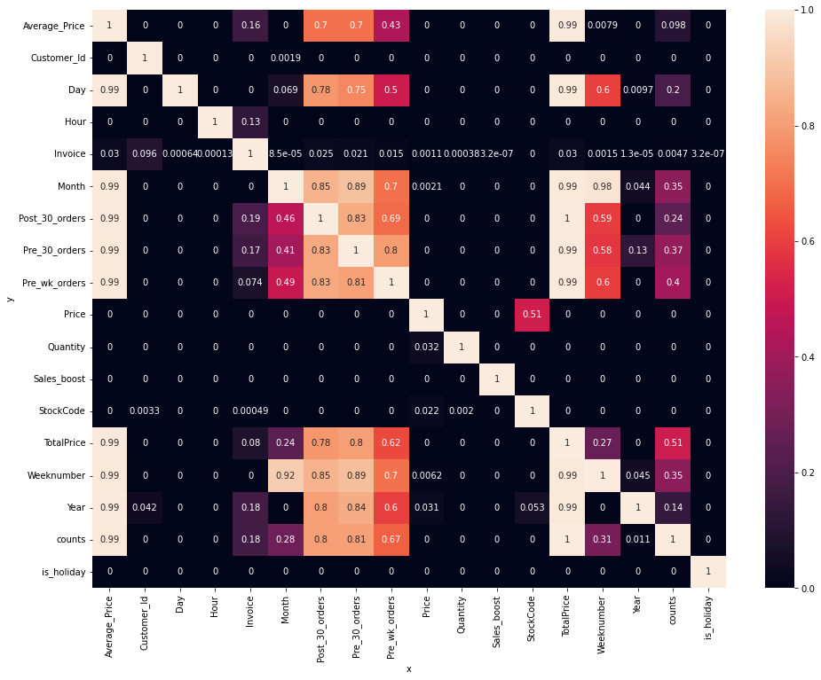
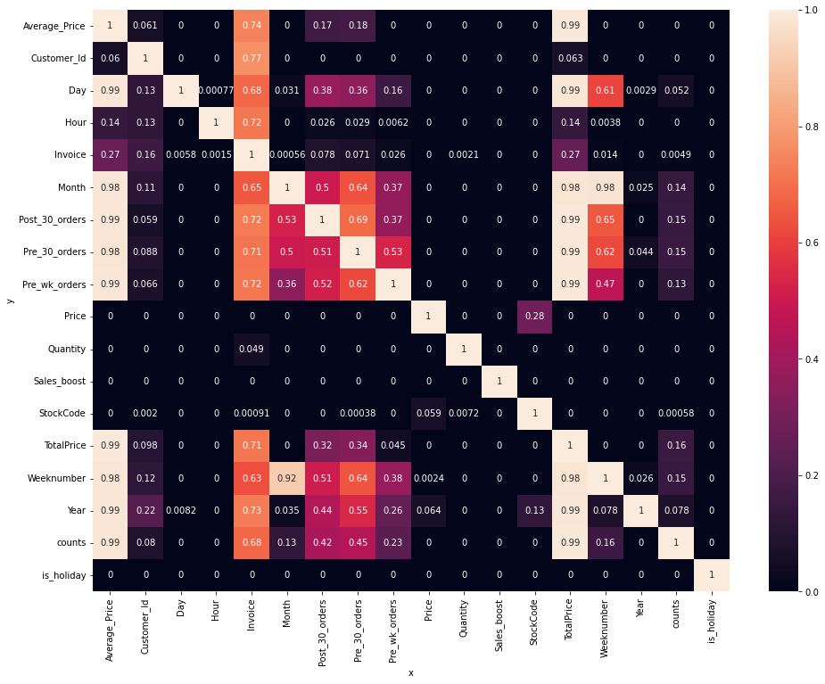
Predict Power Score

Slide 9
PreProcessing
Through the PPS, 9 features were to be focused on which had the highest influence on our predictor variable - counts, TotalPrice, Average_Price, Pre_wk_orders,Pre_30_orders, Month, Year, Day, Weeknumber
In the first step we developed a dummy regressor model by using the mean of prices. This helped in establishing a baseline for comparison.
Pycaret was used inorder to help us speed up selecting the best models that fit our current dataset.
Random Forest Regressor was the chosen to be the ML algorithm that would be used to train on the UK dataset and on the Non-UK dataset

Slide 10
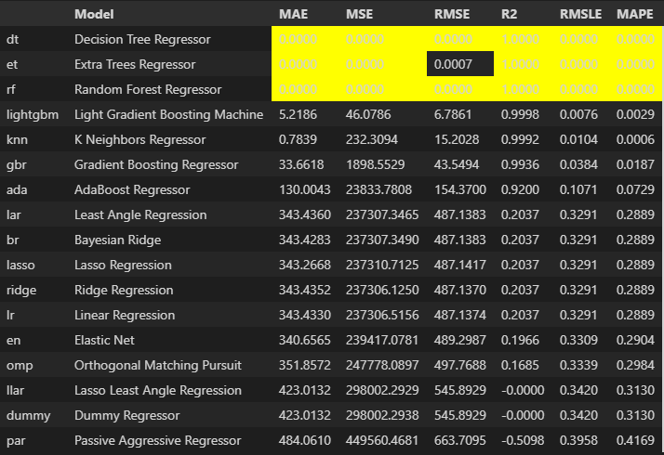
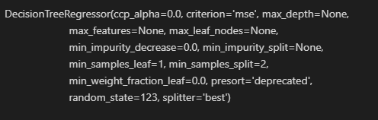

Slide 11
Modeling
In this section, I used the Random Forest Regressor, as the base model and then used hyperparameter tuning inorder to calculate the best parameters that fit the current dataset.
When using the same model on the Non-Uk dataset, the RMSE score was based due the influence and biasing of the dataset towards the UK dataset.
Inorder to overcome, this a Voting Regressor was used which fed the data from 2 individual RF models and helped remove the biasing towards the UK dataset.

Slide 12
Conclusion
Recommendations – Due to this forecasting, we can easily know the expected number of upcoming orders in the store and accordingly setup the manpower, stock of the goods and hire to meet the demands.
Future Work
Get data related to operational process
Calculate the return rate of customers based on CustomerId
Perform market basket analysis for the customers

